Slide 1


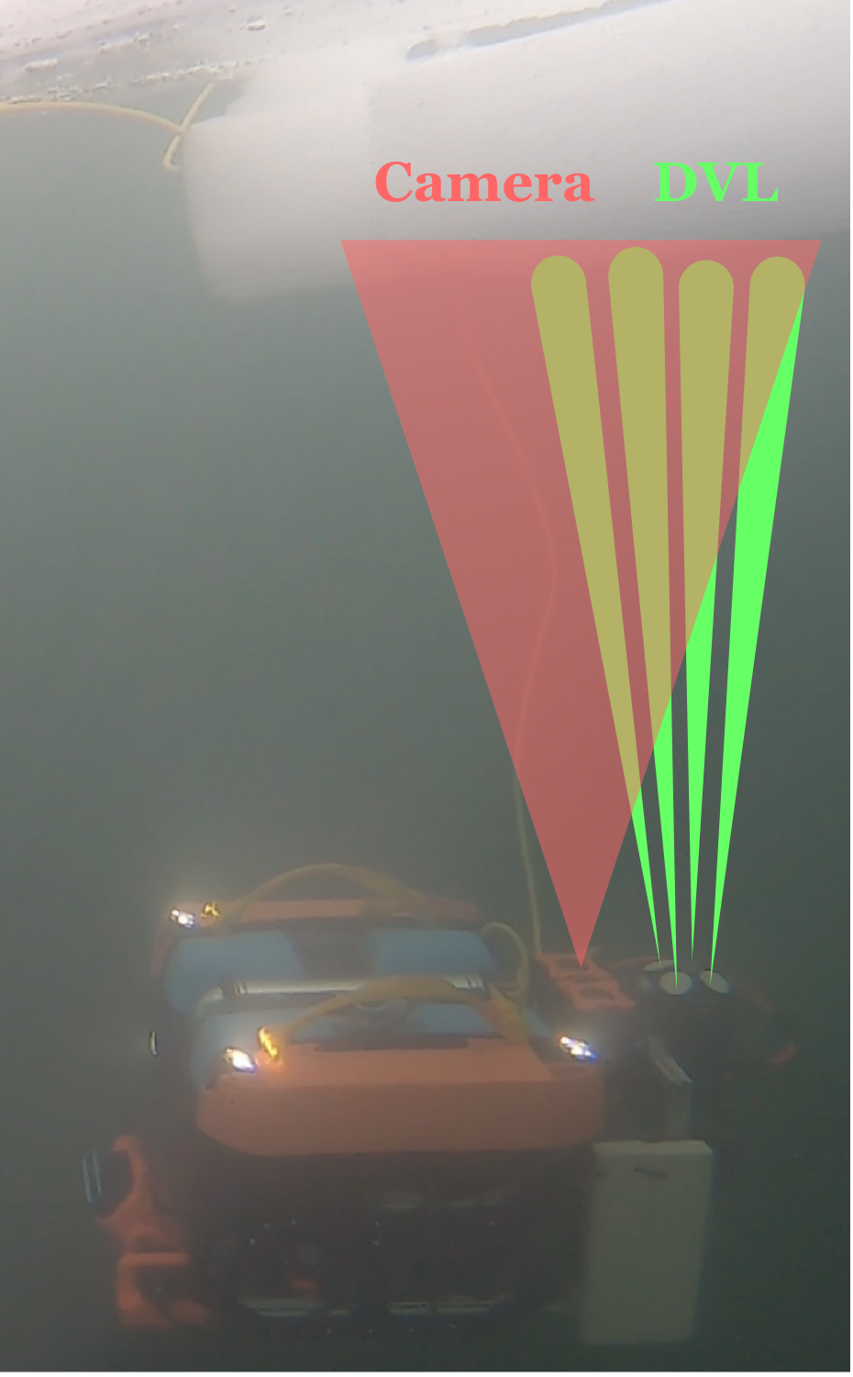
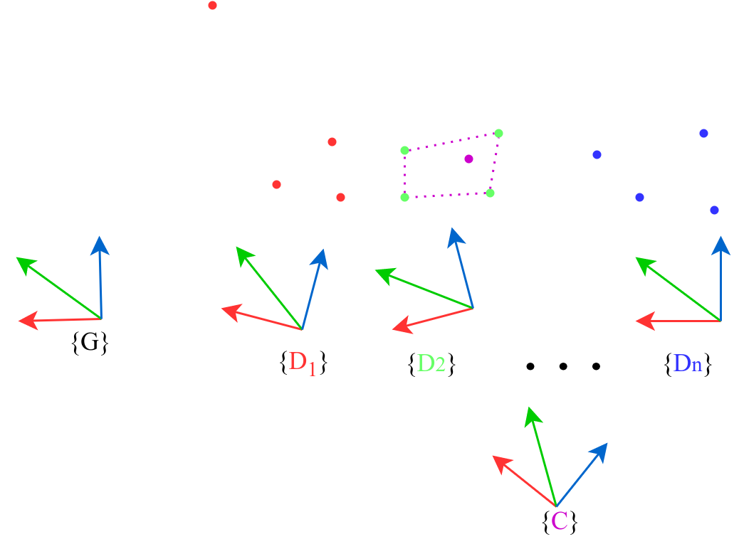
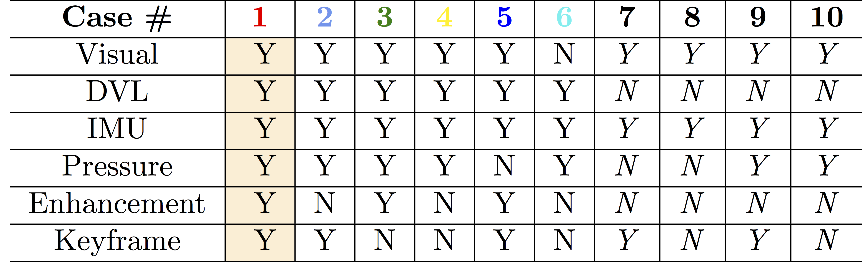
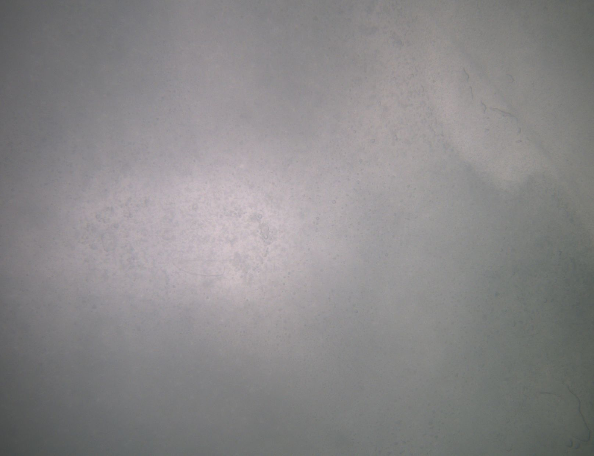
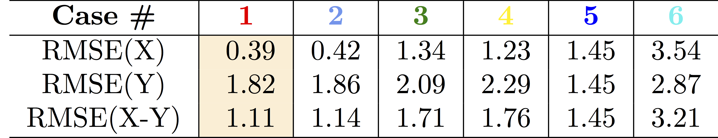
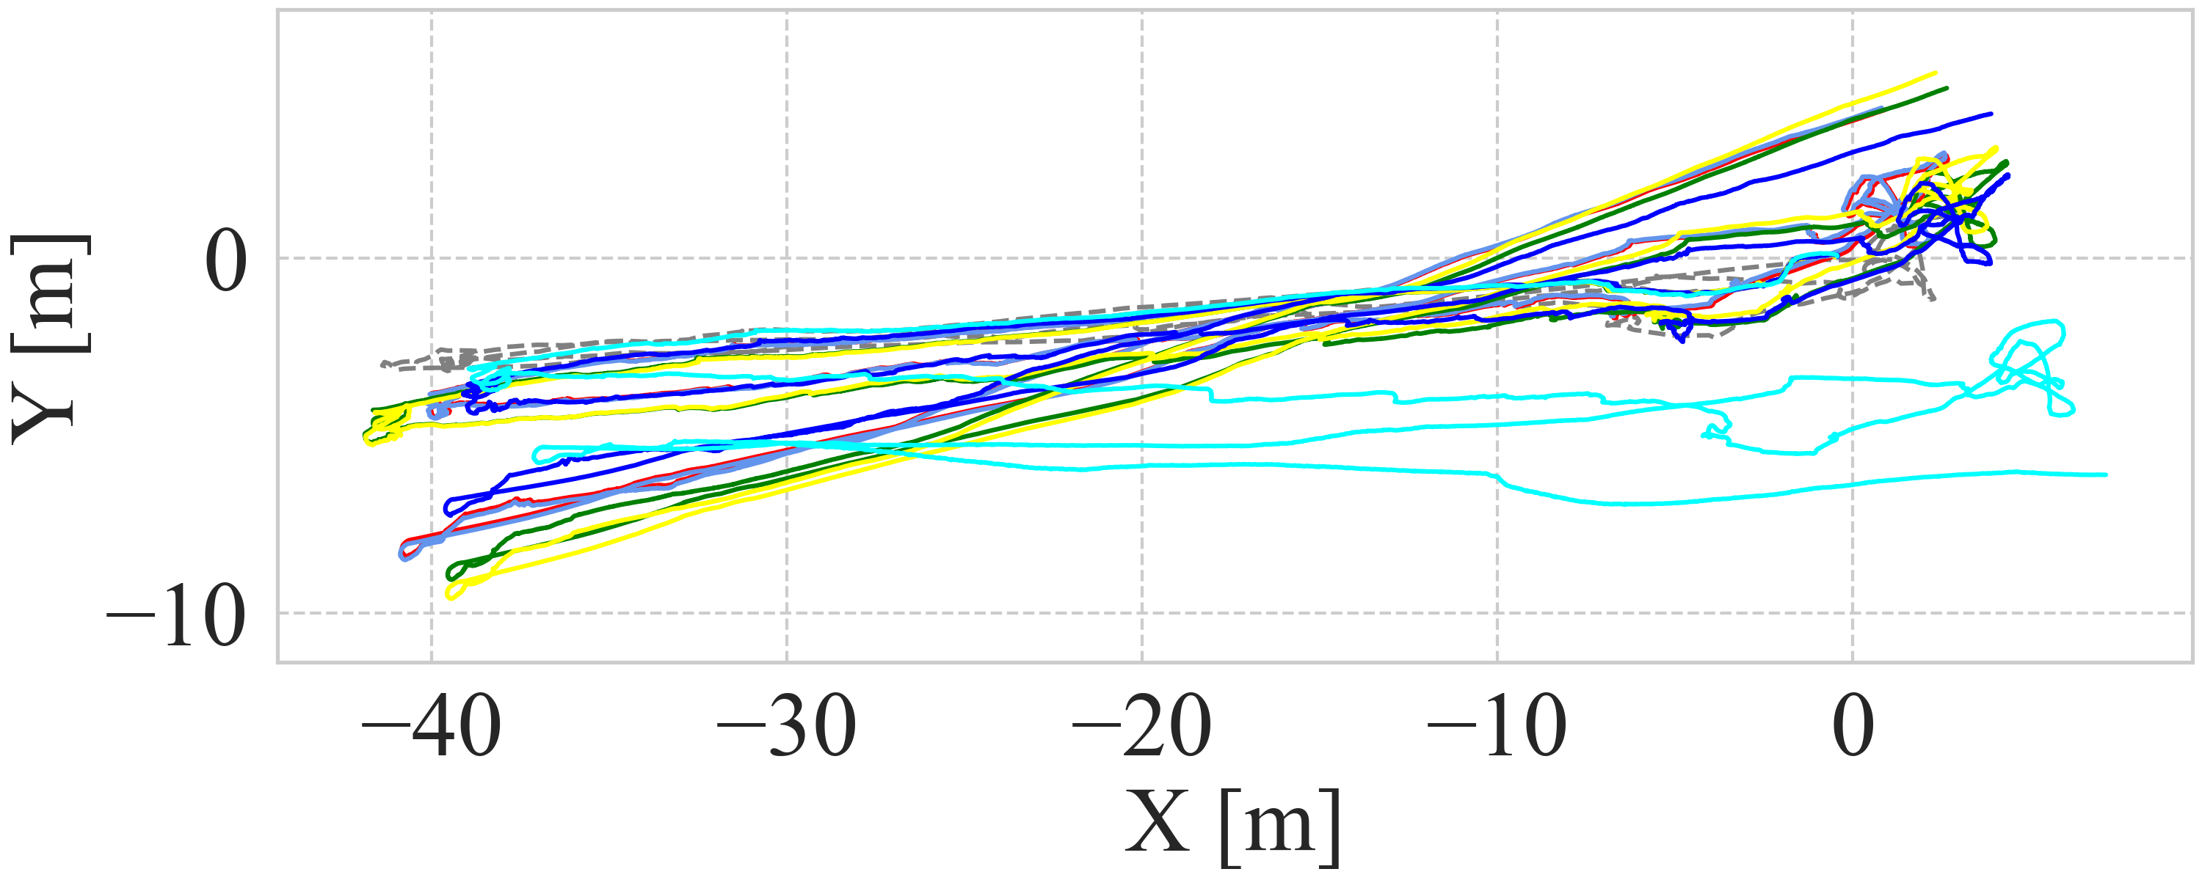
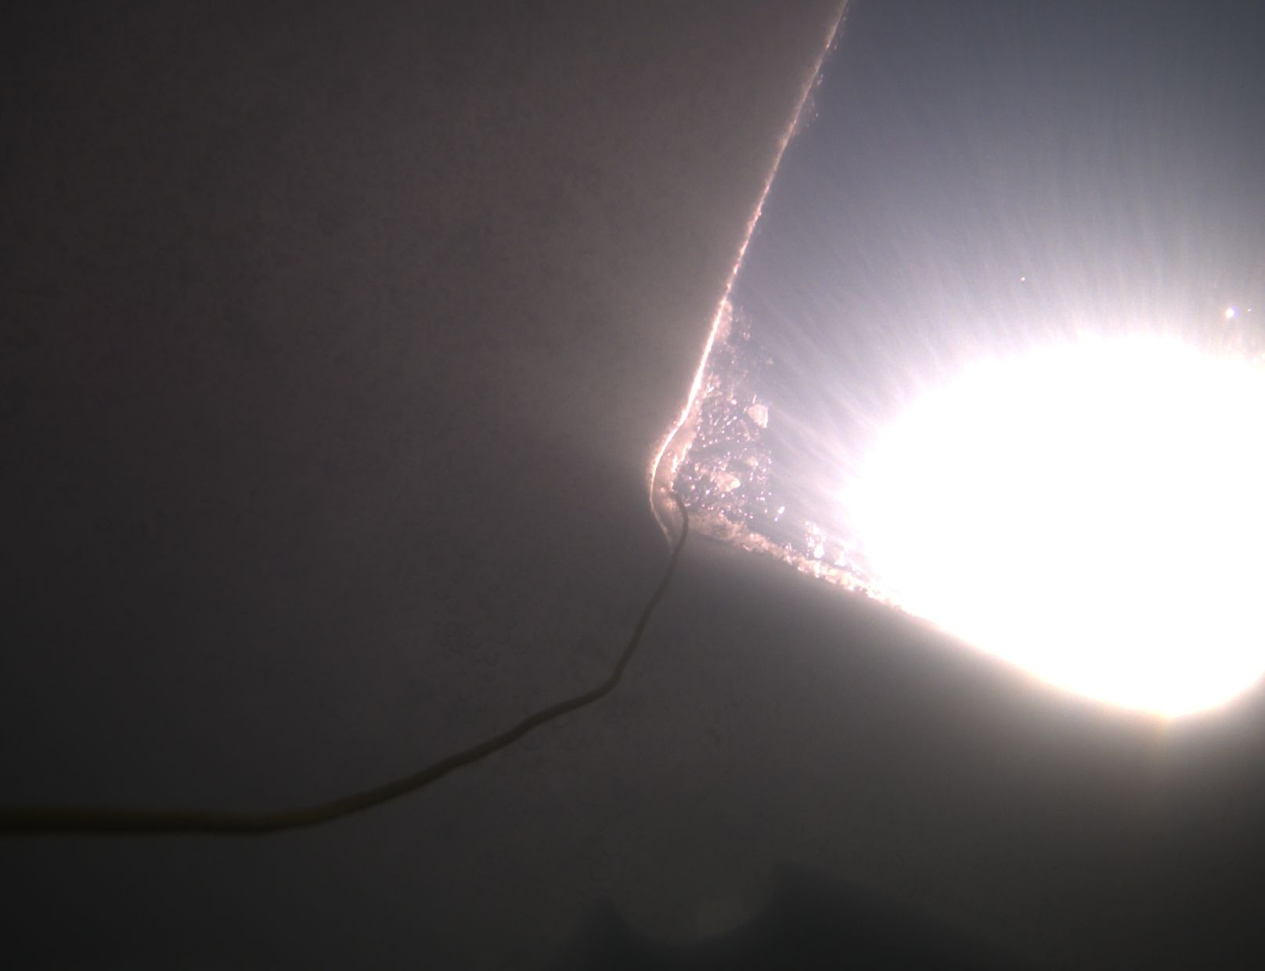
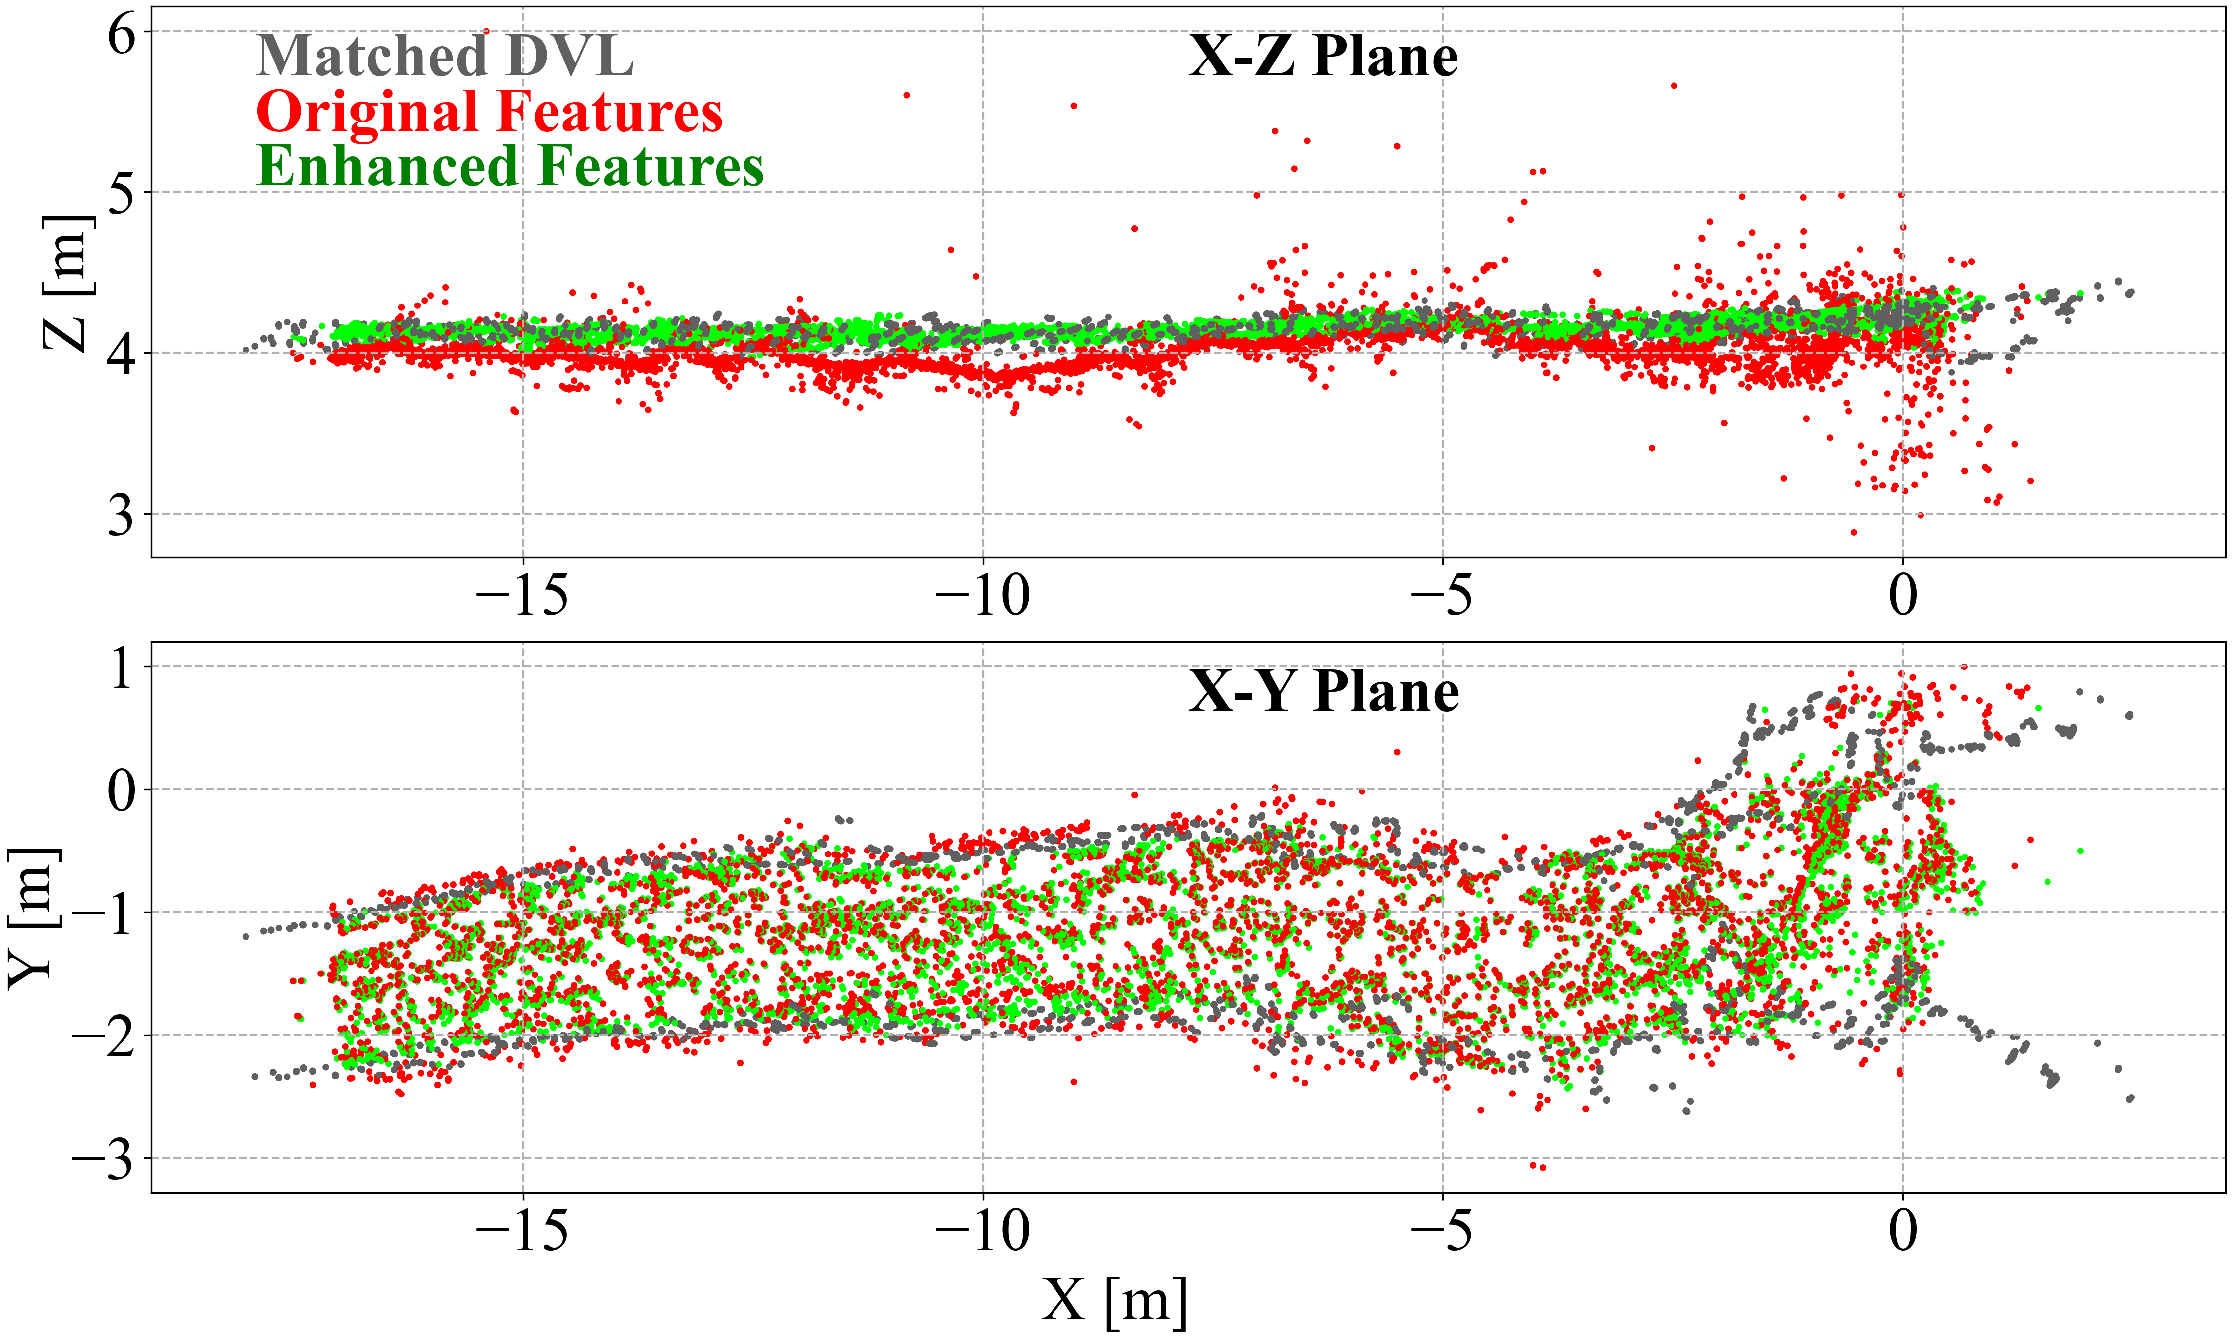
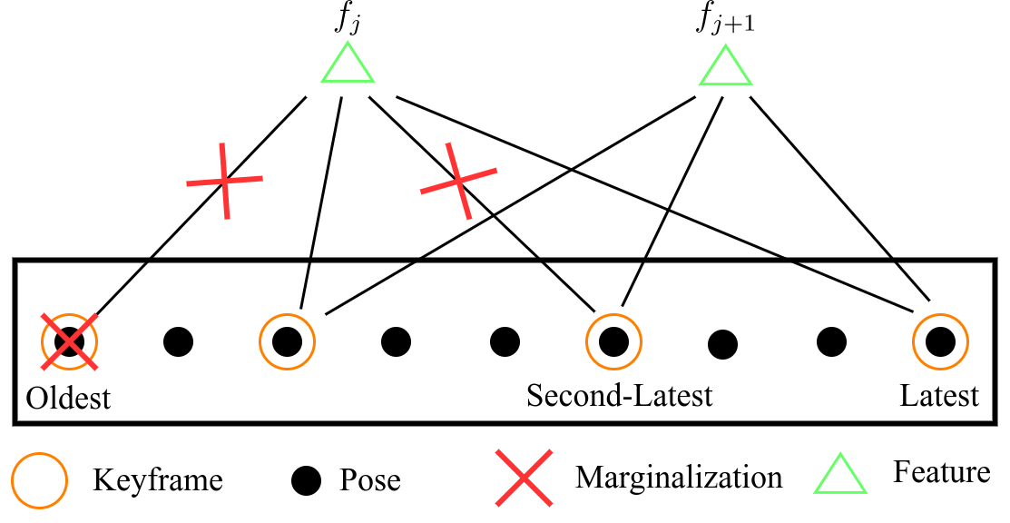
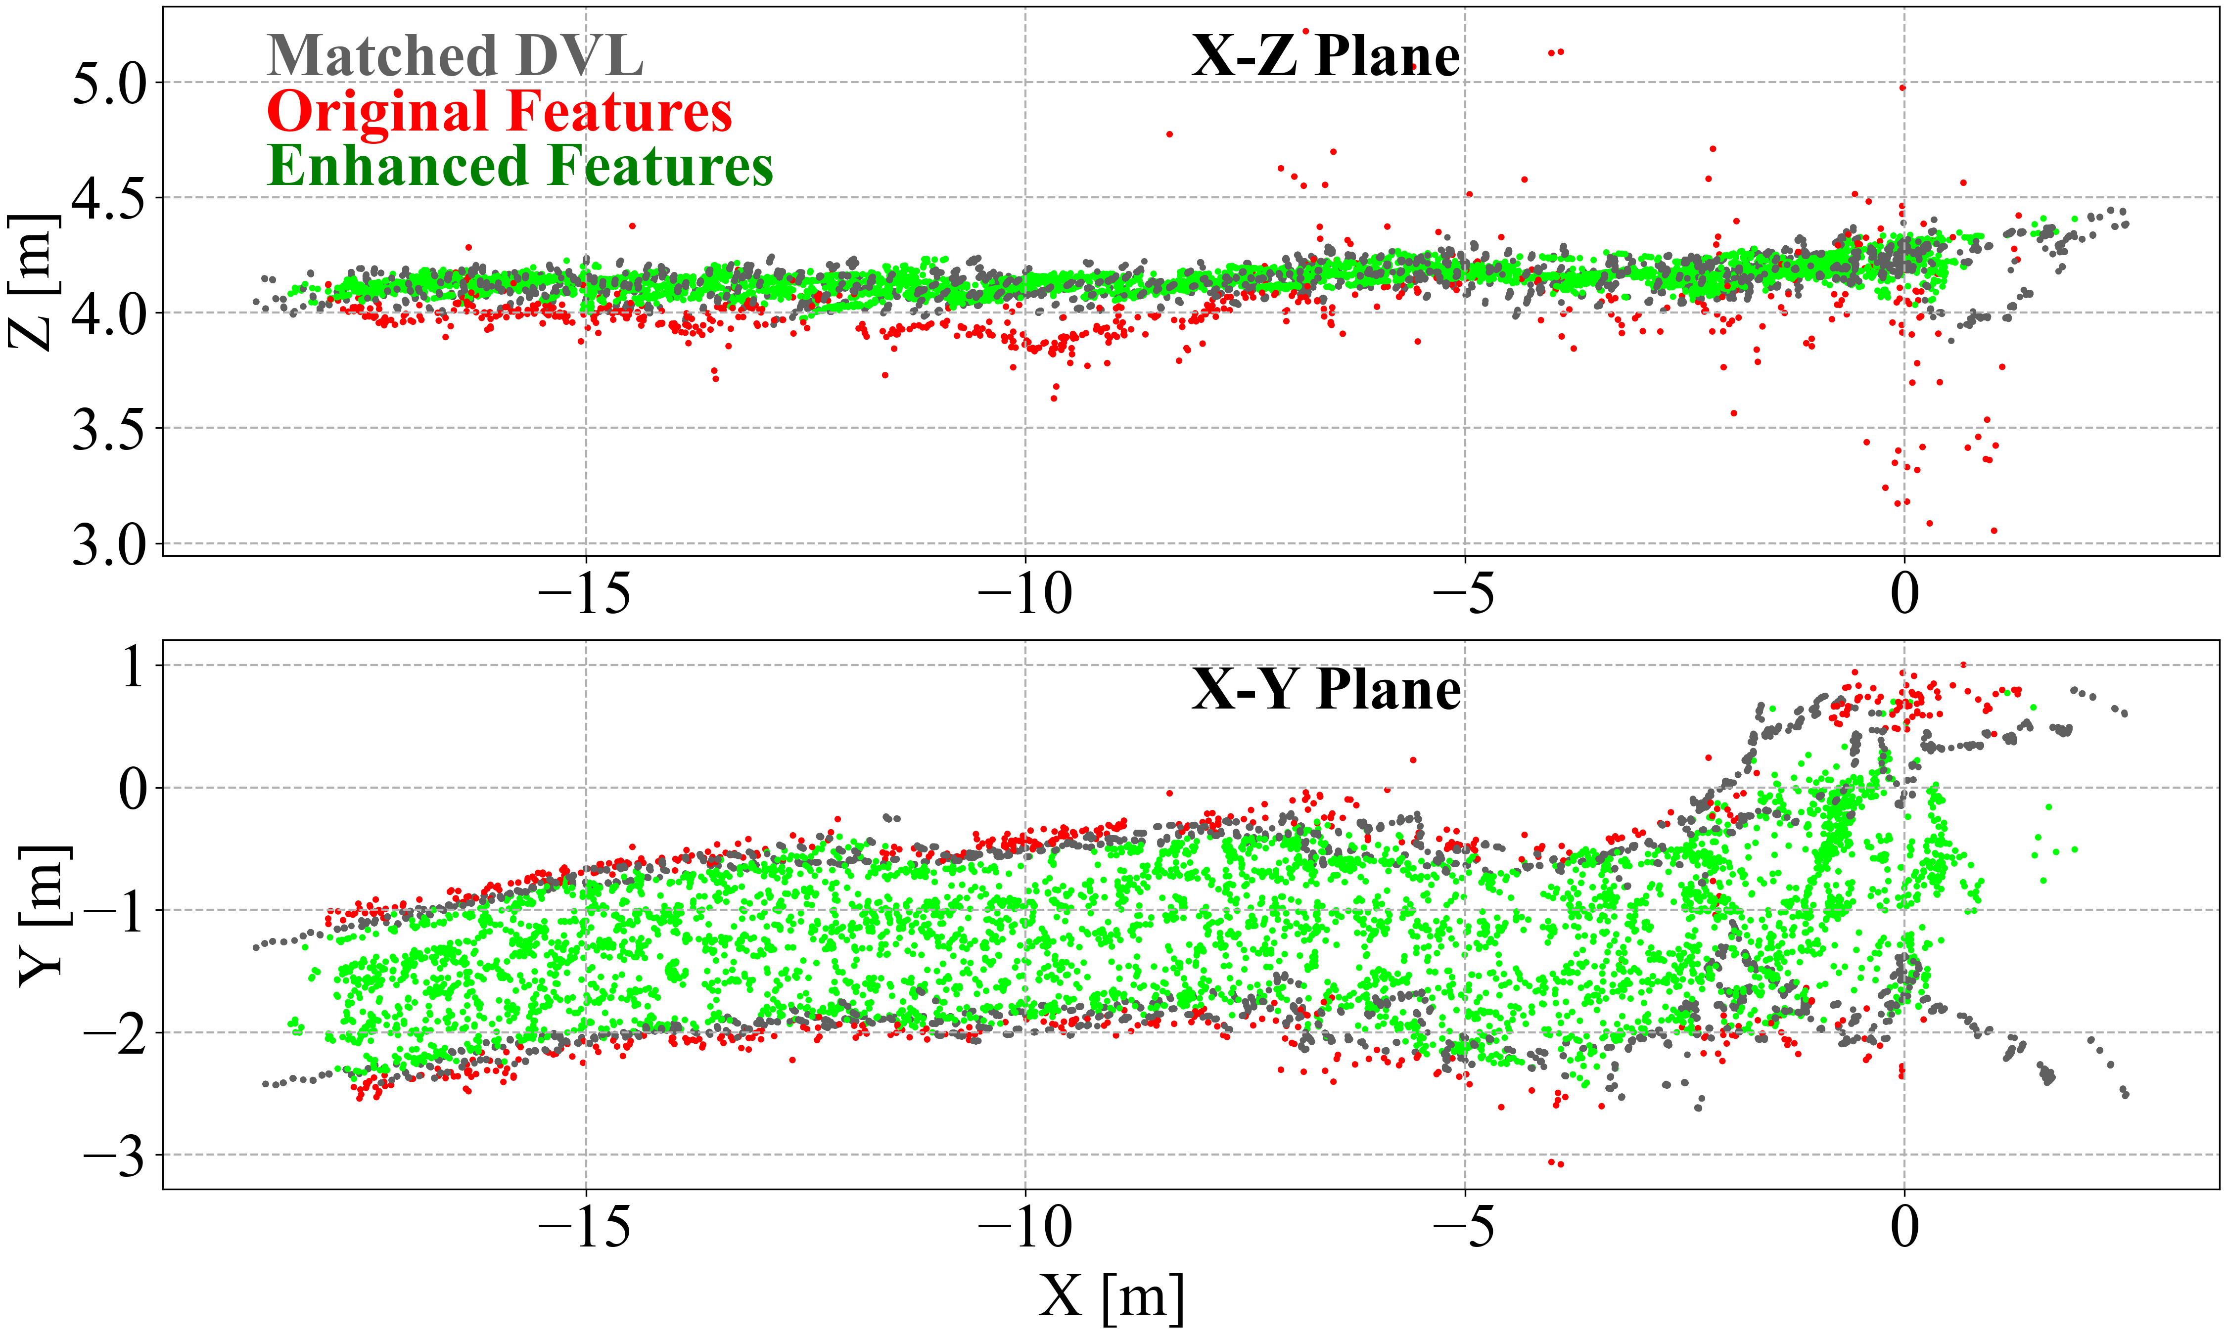



Tightly-coupled Visual-DVL-Inertial Odometry
for Robot-based Ice-water Boundary Exploration
Lin Zhao, Mingxi Zhou, Brice Loose
Introduction
DVL-aided Enhancement
Localization result
Motivation:
Underwater visual-based methods are challenging due to the degenerate motions and degraded image conditions.
Additional sensors are required for robust state estimation.
Featureless
Filter multi-path caused by ice-opening
Transfer to normalized camera 2D plane
Check if feature inside arbitrary quadrilateral
Bilinear interpolation the depth from quadrilateral
Apply the rescale ratio to enhance feature
Dynamic illumination
Vehicle Deployment
Enhancement Result
Contributions:
Modified keyframe marginalization to improve the vaild feature update
DVL point cloud aided feature enhancement
Under-ice dataset validation
Keyframe marginalization improved the performance
DVL enhanced the feature estimation and increased the accuracy
Modifed Marginalization
Acknowledgments
Acknowledgments
Triangulated and enhanced features
This work is supported by NSF under the award #1945924 and the Graduate School of Oceanography, University of Rhode Island. We also thank the field support from the Great Lake Research Center, Michigan Technological University
Insert keyframes based on motion and scene constraints:
improve triangulation performance
Marginalize the oldest pose & features from oldest and second-latest:
each feature update will provide large constraints
Un-matched and matched features
Enhanced features align with DVL point cloud
Most of features can be enhanced by DVL
linzhao@uri.ed
Lin Zhao
Code

